Slide 1
Előre Makeup Sustainability Scoring Mobile App
By Team Előre

Slide 2
"No matter what, sustainability is no longer a niche play: your bottom-line and brand growth depends on it.” According to Nielsen research, 81% of respondents said “It is extremely or very important that companies implement programs to improve the environment.”
https://www.nielsen.com/us/en/insights/article/2018/was-2018-the-year-of-the-influential-sustainable-consumer/

Slide 3
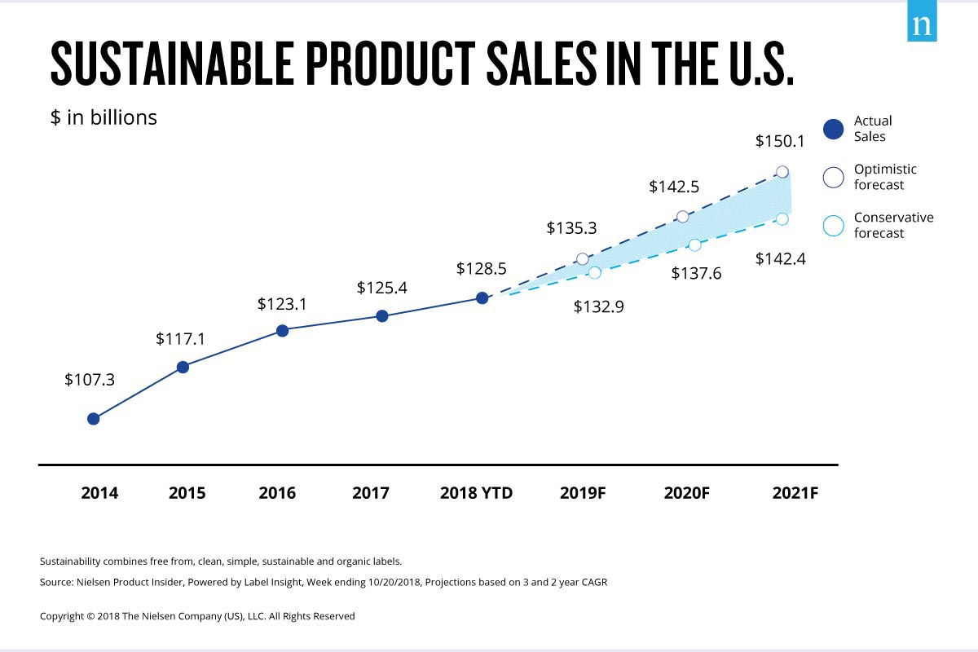

Slide 4
Our Purchase Decisions Make an Impact
Every choice we make has an impact on our world, usually a negative one. Consumers are finally demanding sustainable products, but as that becomes a trend, with natural, cruelty free, vegan and sustainable plastered all over marketing, it’s easy to think we’re making good choices when we’re actually not.

Slide 5
Előre’s Mission
If a consumer is going to pay a premium price tag, they want a way to make sure that those dollars coming out of their pockets are going to make an impact. So we have created an app called Előre which means forward in Hungarian, to help consumers score the impact of what’s currently in their makeup bag and suggest product swaps to increase that score based on 6 criteria:
Vegan/Cruelty-Free
Water impact
Clean Energy
Inclusion & Diversity
Waste
Child Labor Employment

Slide 6
Why Előre
Estee Lauder born, Josephine Esther Mentzer, was of Hungarian and Jewish decent. We wanted to incorporate her heritage into our team’s branding by using the term Előre which means forward in Hungarian. Our mission is to encourage app users and beauty enthusiasts to use products that promote both environmental and social sustainability as an effort for humanity to move forward.

